Slide 1
Facial Nerve

Slide 2
Cranial nerves
Largest cranial nerve – trigeminal
Longest cranial nerve – vagus
m/c paralyzed – facial nerve
m/c involved in intracranial lesions- abducent
Longest – Intracanalicular course- facial
Dorsal aspect of brain- trochlear - most slender
Only motor branch of 9th cranial nerve –
Stylopharyngeus
True peripheral n except- optic tract
Monosynaptic reflex in brain – jaw jerk/masseteric reflex

Slide 3
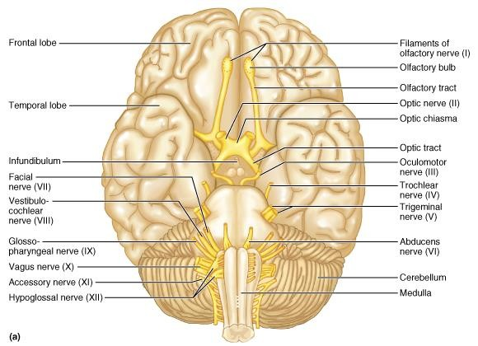
Cranial Nerves
Figure 13.4a

Slide 4
Location of cranial nerves
Anterior cranial fossa: C.N. 1–2
Middle cranial fossa: C.N. 3-6
Posterior cranial fossa: C.N. 7-12

Slide 5
Sensory nerve
Olfactory (1)
Optic (2)
Vestibulocochlear (8)

Slide 6
Motor nerve
Oculomotor (3)
Trochlear (4)
Abducens (6)
Accessory (11)
Hypoglossal (12)

Slide 7
Mixed nerves
Trigeminal (5)
Facial (7)
Glossopharyngeal (9)
Vagus (10)

Slide 8
Innervation of Branchial arch muscles –Mixed nerves
1 - Trigeminal
2 - Facial
3 - Glossopharyngeal
4 – Vagus - SLN
5 – Regresses
6 – Vagus - RLN

Slide 9
Cranial Nerve VII: Facial
Fibers leave lower pons,
travel through internal acoustic meatus,
emerge through stylomastoid foramen
to lateral aspect of face
Pass through Parotid gland
Mixed nerve with five major branches
Motor functions include facial expression,
autonomic impulses to lacrimal & salivary glands
Sensory function is taste from anterior two-thirds of tongue – Chorda tympani n

Slide 10
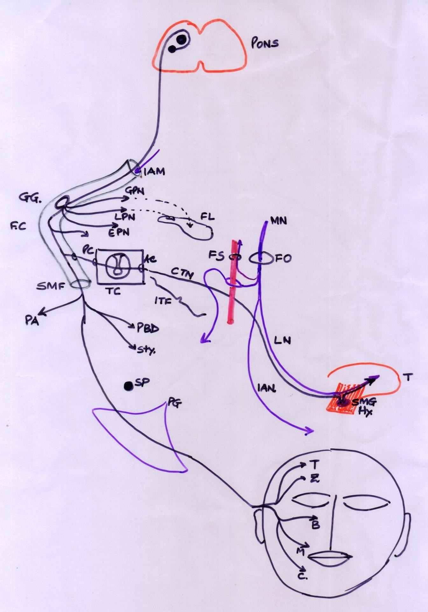

Slide 11
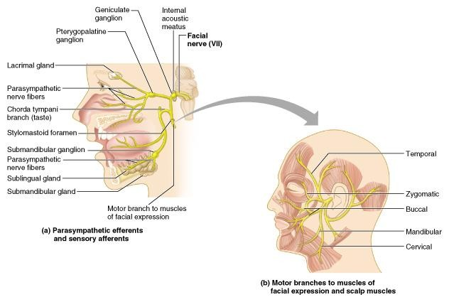
Cranial Nerve VII: Facial
Table 13.2(VII)

Slide 12
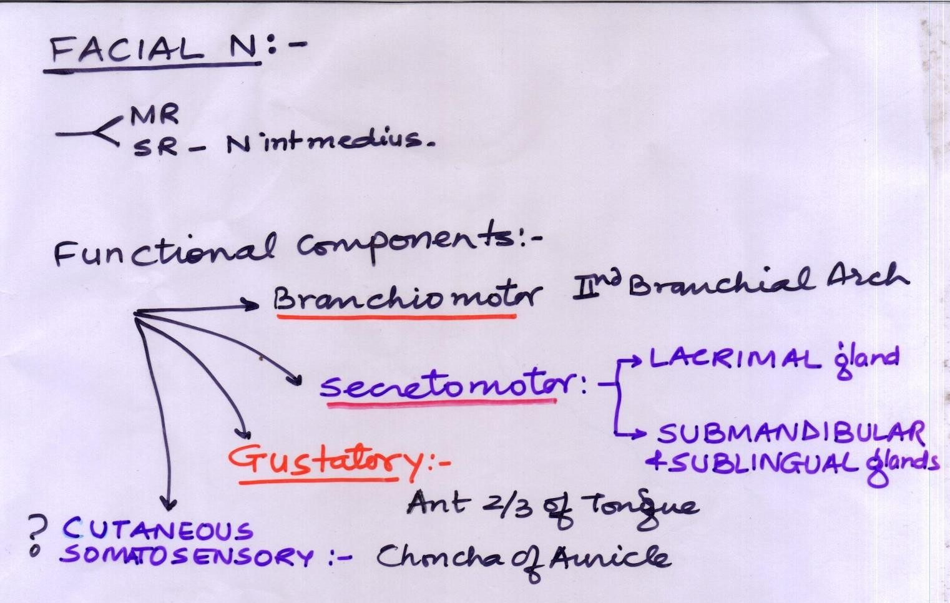

Slide 13
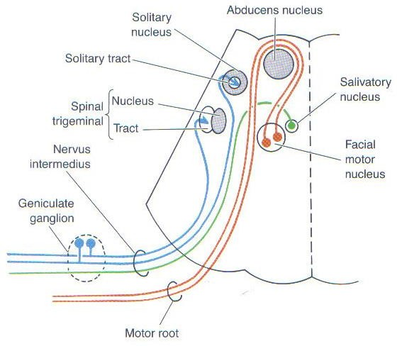
Facial colliculus

Slide 14
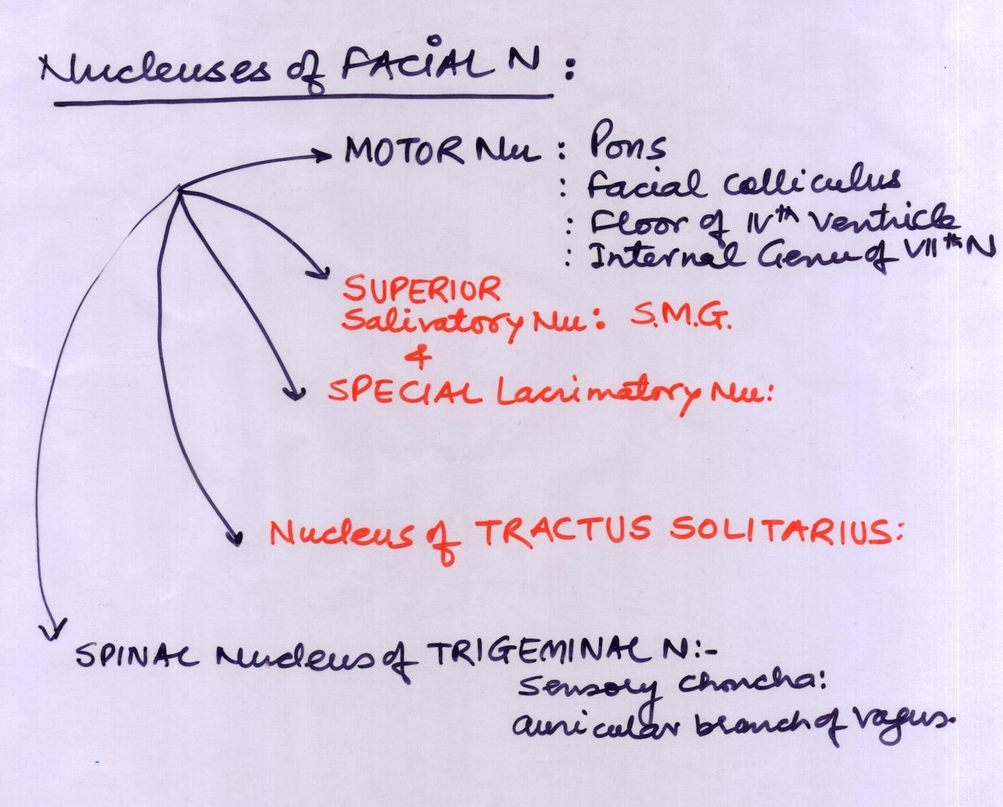

Slide 15
1. Motor nucleus of facial nerve (facial nucleus)
🡪 2nd branchial arch muscles 🡪 muscles of facial expression .
Superior salivatory nucleus - To chorda tympani branch 🡪joins lingual branch of Lingual n -V3 - in Infratemporal fossa 🡪 submandibular ganglion 🡪 submandibular, sublingual & acc lingual glands
Lacrimal nucleus - greater petrosal branch + deep petrosal n - pterygopalatine ganglion 🡪 Lacrimal glands & paranasal sinuses

Slide 16
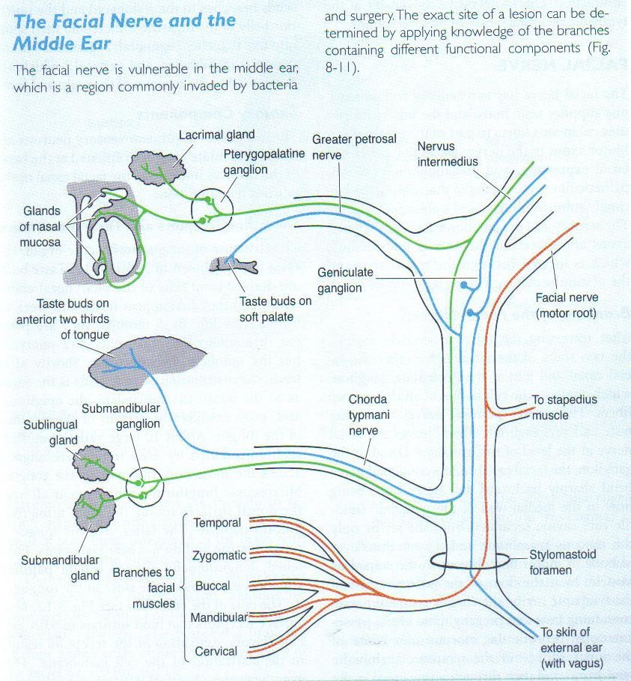

Slide 17
Geniculate ganglion
Central processes nervus intermedius
Peripheral processes chorda tympani, greater petrosal and deep petrosal nn 🡪 vidian nerve 🡪 Pterygopalatine ganglion.
(some fibers join the auricular branch of the vagus)
Gustatory nucleus - nucleus of tractus solitarius
Nucleus of spinal trigeminal tract - From nervus intermedius

Slide 18
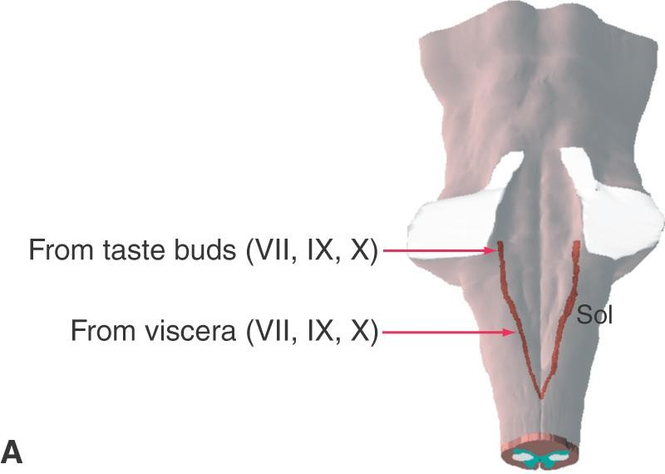
Taste

Slide 19
Taste sensations
Facial N.
Glossopharyngeal N.
Vagus N.
Nucleus tractus solitarious

Slide 20
Parasympathetic ganglion
Ciliary ganglion Pterygopalatine ganglion Submandibular ganglion Otic ganglion

Slide 21
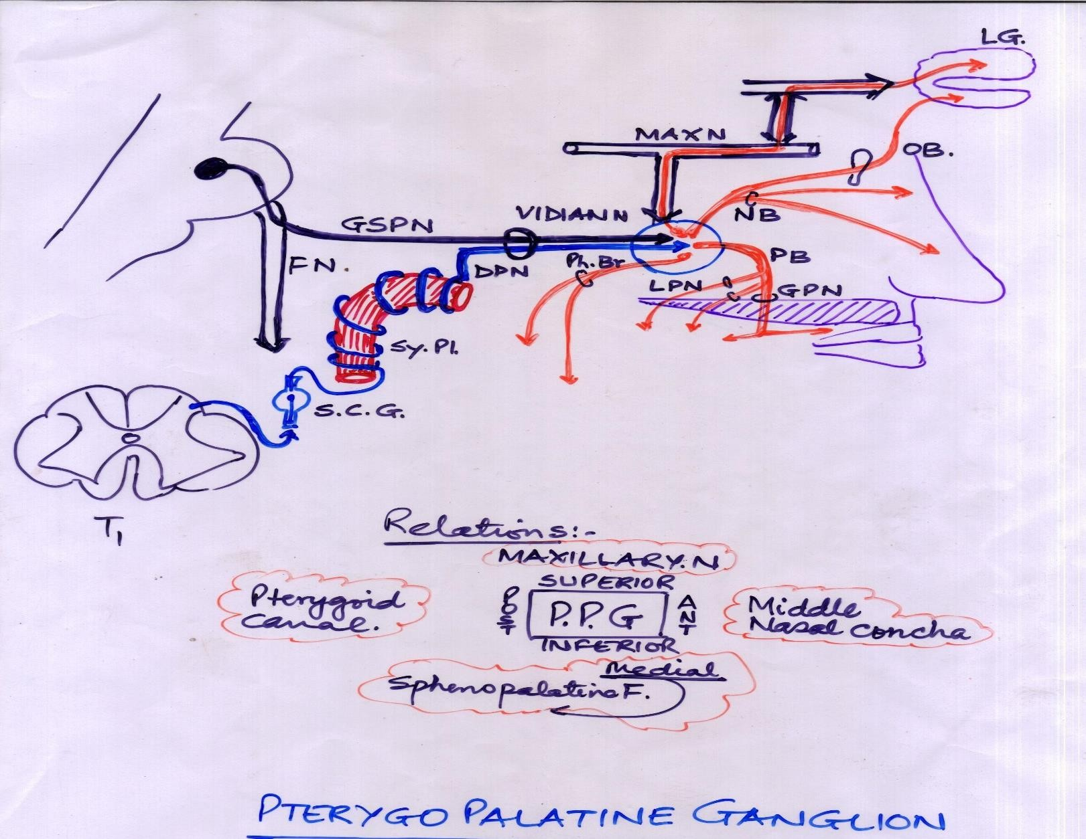

Slide 22
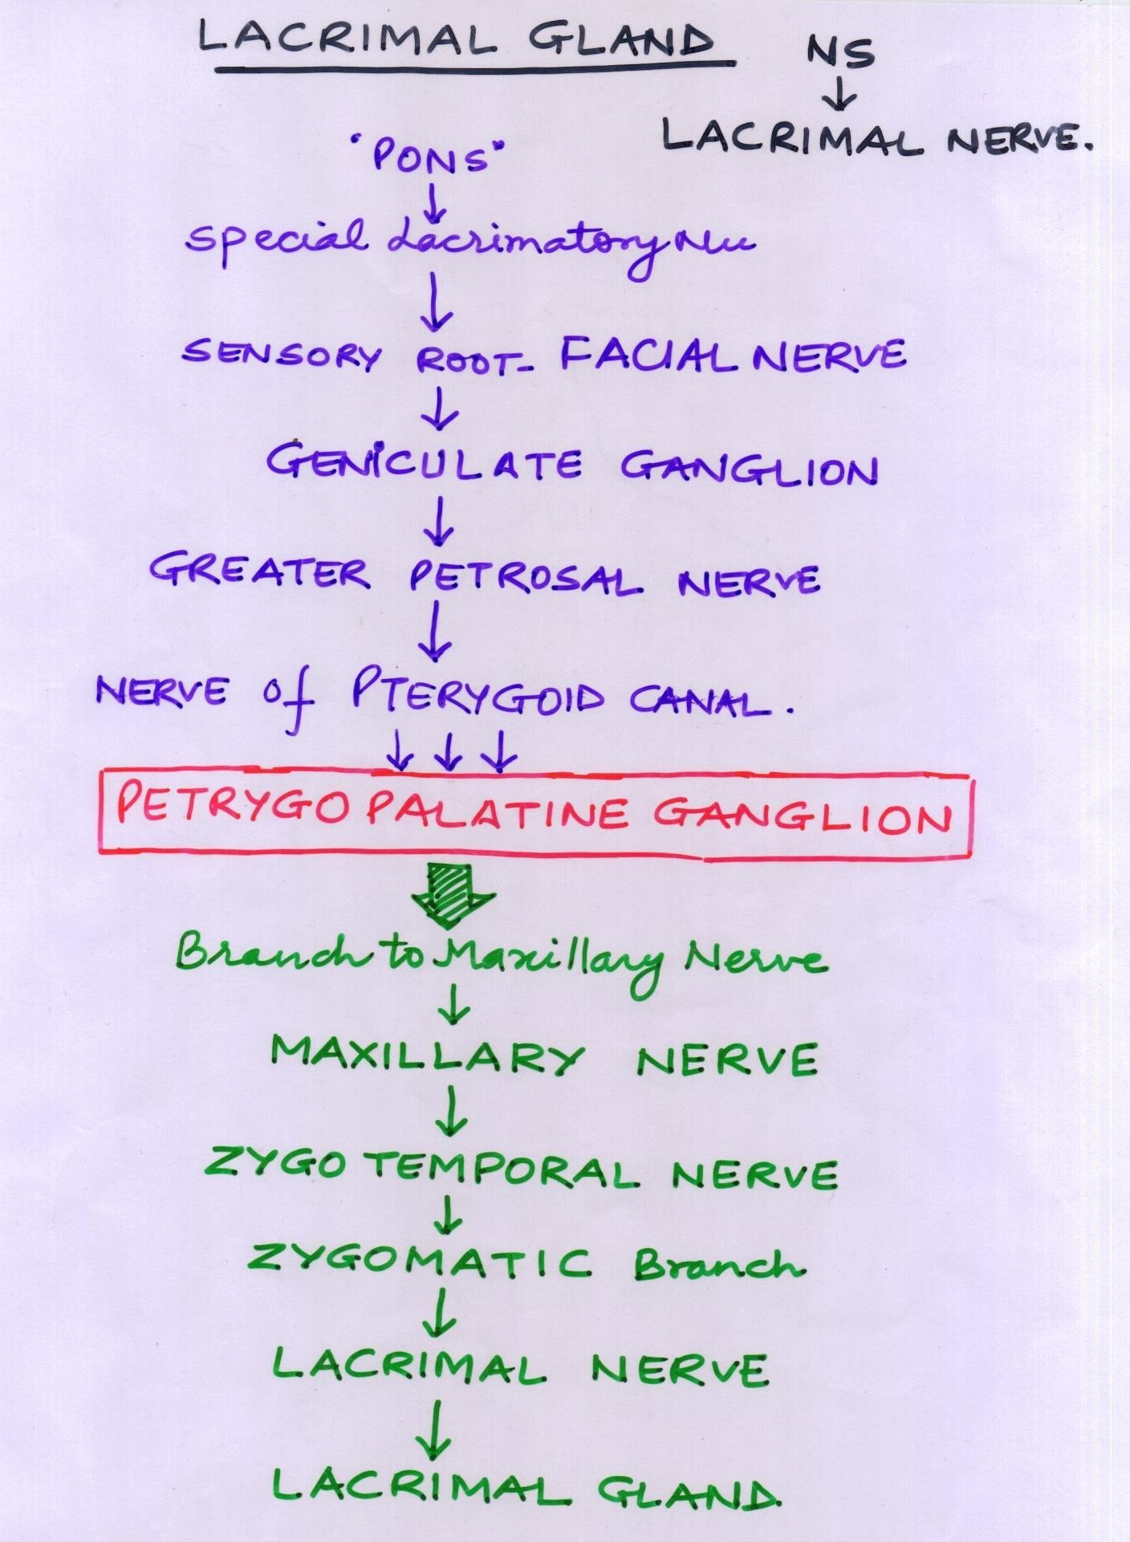

Slide 23
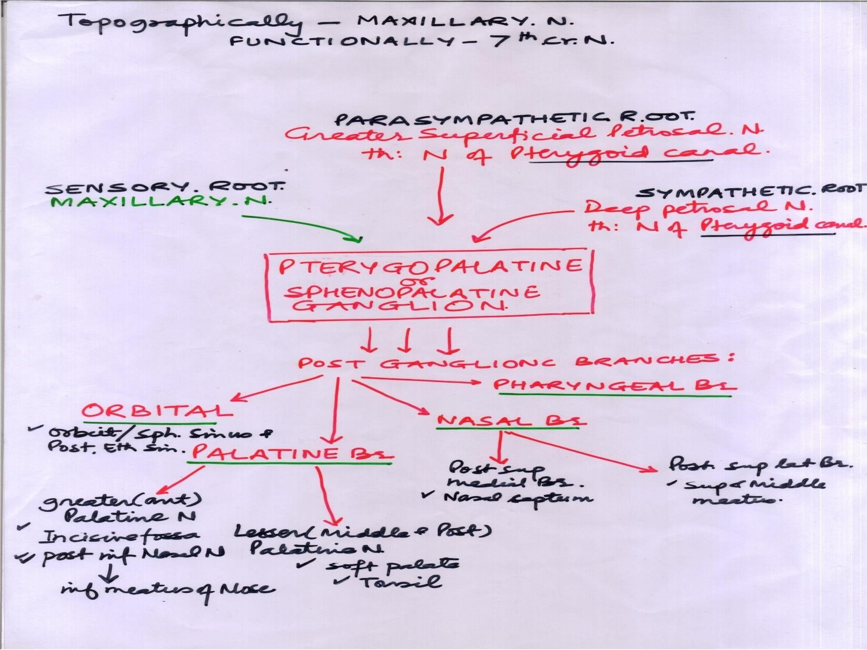

Slide 24
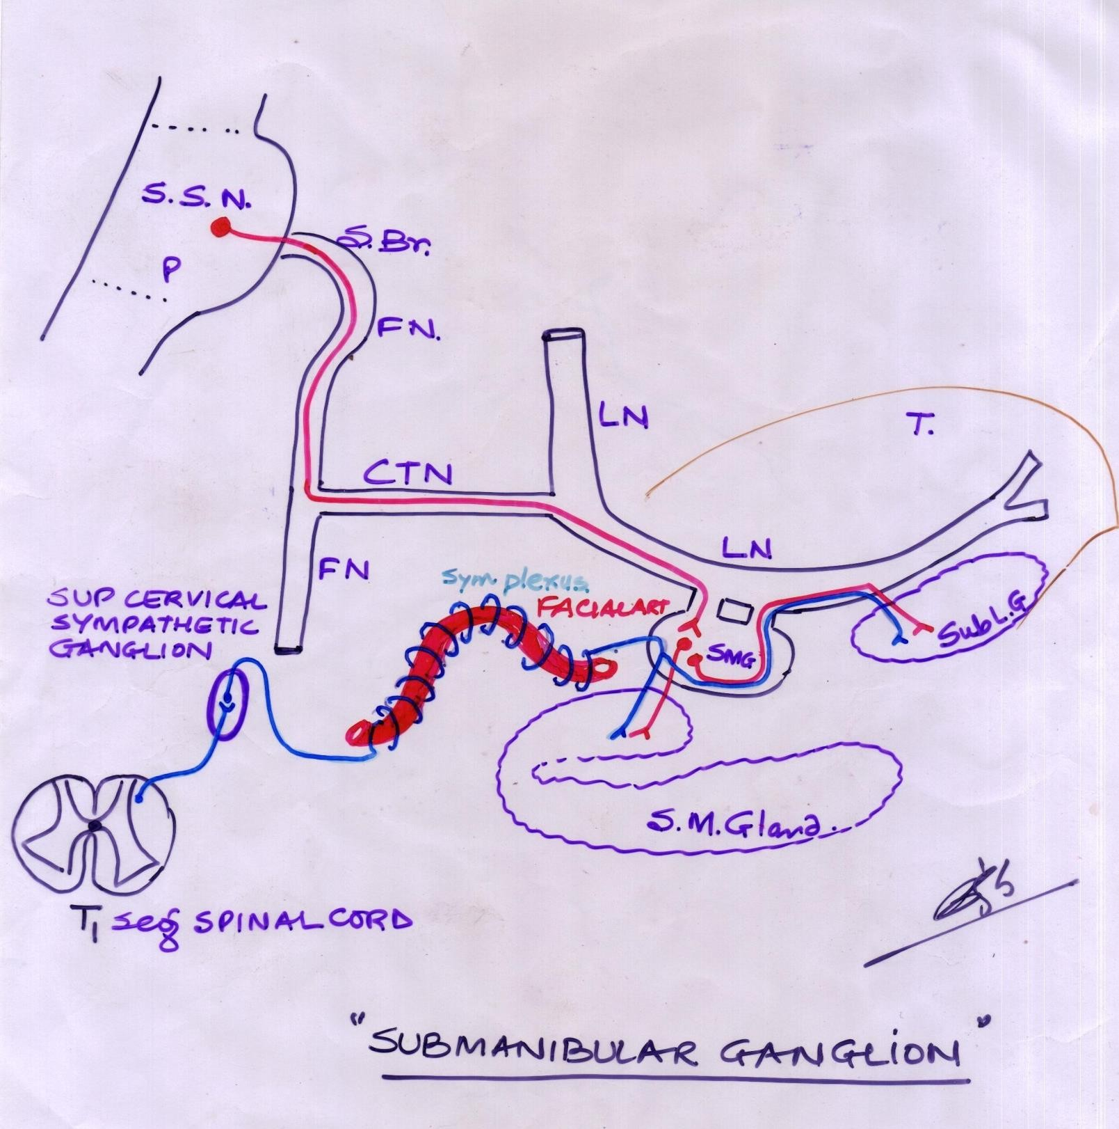

Slide 25
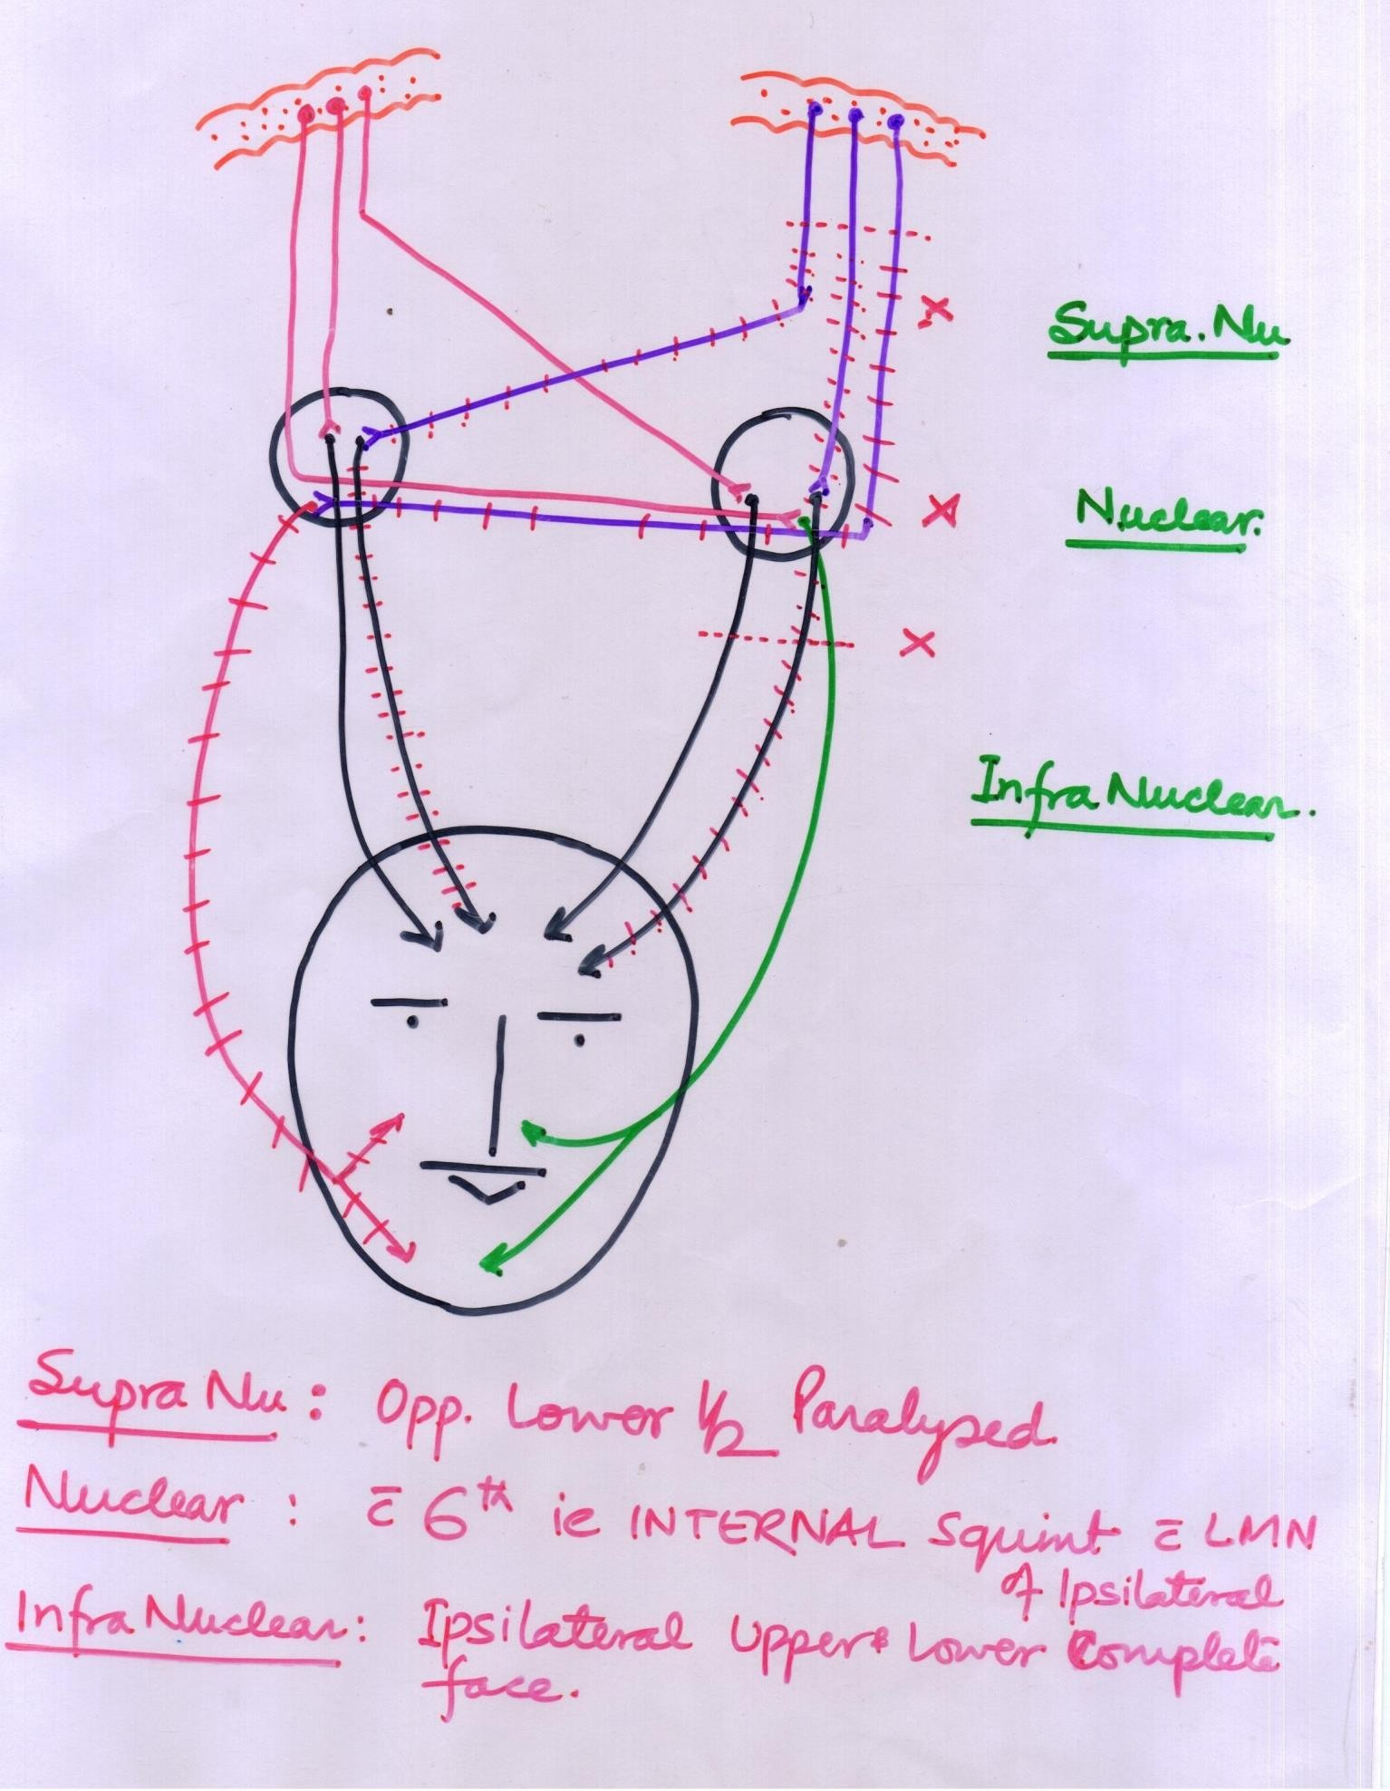

Slide 26
Facial palsy-S.N.Palsy.
CVA-internal capsule - HT
Cortico nuclear- cortico - bulbar fibers are involved
Loss of movement of lower half of face on opposite side of lesion
Upper half of face escapes b/of bilateral representation in cortex
NUCLEAR PALSY-LMN type of palsy of same side upper & lower half with ipsilateral 6th nerve palsy ie internal squint– LR6

Slide 27
Facial nerve palsy
Millard Gubler syndrome - contralateral hemiplegia & ipsilateral facial palsy b/of pontine lesion- affects pyramidal tract & facial nucleus.
Infra nuclear palsy - bells palsy - LMN Palsy - same side complete face paralysis.
Internal acoustic meatus- LMN Palsy &
deafness-8th cr n.
Lesion at genu – geniculate ganglion -
diminished lacrimation

Slide 28
Facial nerve palsy
& salivation by submandibular gland, hyperaccusis b/of stapedial muscle palsy , + LMN palsy same side.
Facial canal- CTN – bell palsy &Taste loss of ant 2/3 tongue – clinically ??
Crocodile tears - during recovery
Stylomastoid foramen - bells palsy
Bells phenomenon - while closing eye lids affected side eye rolls upward,
Reaction to degeneration appears

